Slide 1

Digitaliseringen och samhällskonsekvenserna
Jan Olsson
SC3

Slide 2
Är Cyberbrott ett problem?
Låt oss titta på en del av brottsligheten på nätet, exempelvis Bedrägerier.

Slide 3
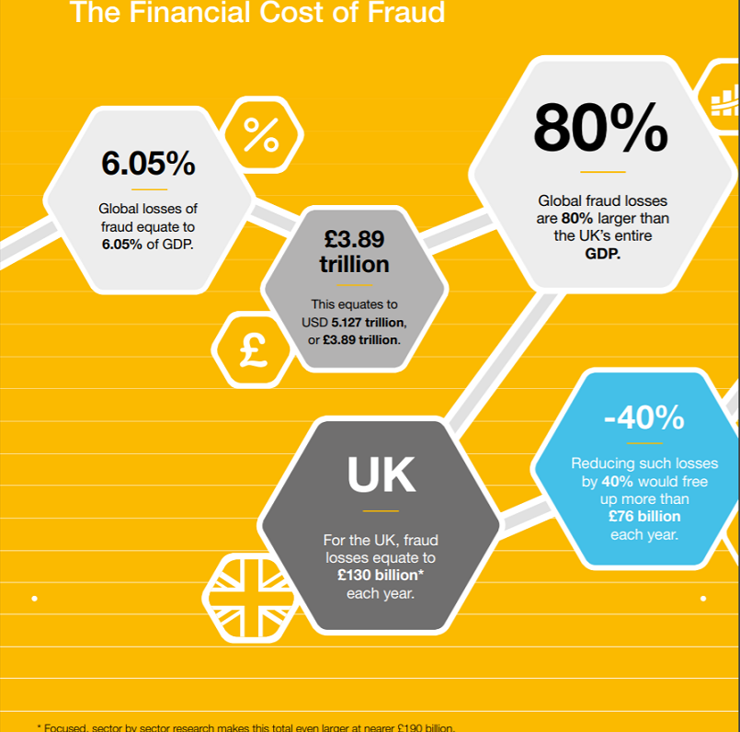
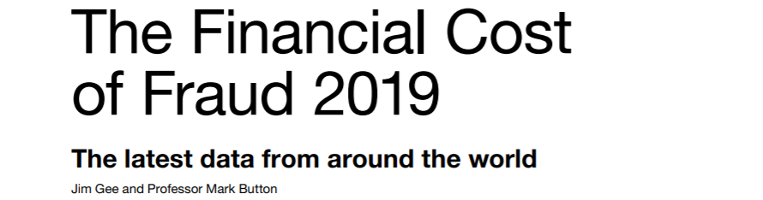
The United Kingdom Fraud Costs Measurement Committee (UKFCMC)
190 miljarder Pund/år
Notes:
Det görs inga ekonomiska kalkyler i Sverige gällande den totala samhällskostnaden av bedrägerier för allmänhet, företagen och staten vilket är konstigt, kanske är det inte intressant?
I England tar man det desto allvarligare och satsar mycket på att årligen genomföra beräkningar av kostnaderna för det engelska samhället. Sedan flera år tillbaka leds denna forskning av University of Portsmouth.

Slide 4
2.200.000.000.000 Sek
Motsvarar 31.534 Sek / innevånare i England
Notes:
Enligt föregående bild så syns längst ned till höger vid * att kostnaden av enbart bedrägerier för det engelska samhället 2019 var 190 miljarder Pund vilket utslaget på levande personer i England vid nämnda tillfället blir ca 31.000 svenska kronor.

Slide 5
En inte alltför vetenskaplig betraktelse:
- Vi och Engelsmännen ligger båda långt framme när det gäller antalet datorer och internetruppkopplingar. Vi båda handlar mycket på nätet där också ofta bedrägerierna sker..
- Är vi lika naiva / kriminella ?
- Sverige ca 10.230.000 innevånare dec 2019
- 31.534 Sek / Innevånare

Slide 6
Vi svenskar förlorar då varje år:
322.592.820.000 Sek !
Dvs 320 miljarder kronor ….

Slide 7
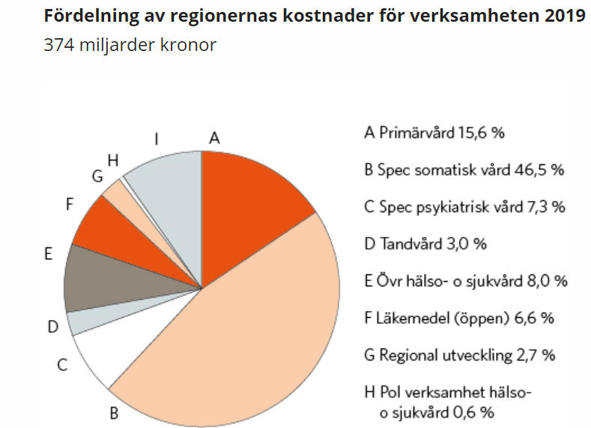


Hur mycket är 322 miljarder kronor då egentligen?
- 6.4 % of BNP (2019)
- 10.112 kr / sekund
Notes:
Gissningsvis gör sig dessa summor bättre i skola, vård och omsorg än i bedragarnas fickor men det tycks ansvariga inte tycke för annars hade det satsas mycket mer på att förebygga dessa brott och att utreda de som ändå sker!

Slide 8
Globala kostnader
47.000.000.000.000 kr = Globala kostnaden av bedrägerier (UKFCMC)
55.000.000.000.000 kr = Globala kostnaden av dataintrång (Nordea)

Slide 9
Dataintrång
Nu reagerar EU äntligen
GDPR
EU
PSD2
CNP
GDPR – Dataskyddförordningen (General Data Protection Regulation
CNP – Köp på nätet med annans kortuppgifter (Card-Not-Present)
Notes:
EU tröttnade på att dels företagen bl.a. inte skyddade sin data tillräckligt väl (GDPR) och dels att handlarna inte identifierade den som handlade med kort utan endast kontrollerade att kortet var kopplat till ett konto med pengar (PSD2). Det som stjäls vid dataintrång (exempelvis kortuppgifter) är det som används vid bedrägerier, varför allt hänger ihop..

Slide 10
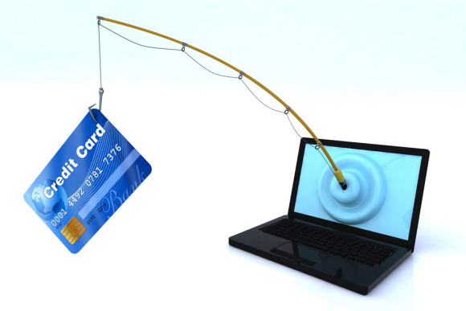
Phishing – Mail fiske

Slide 11
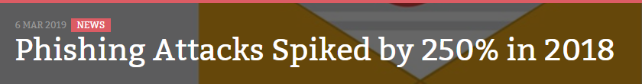

Notes:
https://www.infosecurity-magazine.com/news/phishing-attacks-spiked-by-250-in-1-1/
A new report from Microsoft found that phishing attacks increased 250% over the course of 2018. According to Microsoft’s Security Intelligence Report (SIR) volume 24, attackers have shifted tactics and are now targeting multiple points of attacks within one campaign.
“Hacking is a multi-billion-dollar industry. If it was being run by one company rather than a mix of organized crime syndicates, lone wolves and governments, it would be comparable to a major NASDAQ tech business,” said Colin Bastable, CEO of cybersecurity test and training company Lucy Security.
Alas, malicious actors continue to find success using new tactics, like transitioning from URLs, domains and servers to dispersing emails and hosting phishing forms. The most recent SIR noted that by adopting both hosted servers and public cloud tools, attackers were able to more easily disguise themselves so that they appeared to be legitimate services or products.
“These are smart, motivated people with not much to lose and a lot on the upside. They're ahead of most security vendors in the Cyber Security war, because the vendors play defense,” Bastable stated.
The report evidences the challenges that CISOs and many vendor CTOs have when it comes to understanding the wide range of attack methods and techniques available to hackers. “Malicious actors are always on the lookout for new ways to hack devices and machines,” said Usman Rahim, digital threat analyst at The Media Trust.
“Phishing, whether through email, malvertising, or any other channel, takes advantage of the fact that most consumers pay little attention to details and are likely to click on an email link, an ad, and enter sensitive information when prompted,” stated the report.
Threat actors are becoming more innovate, finding new ways to escape detection by checking for known anti-malware solutions, persisting despite a browser reboot, stealing device information like IPs and switching infection tactics when they’ve been discovered, Rahim said.
“The best defense for organizations is to take a layered approach to security that involves employee training and collaboration with digital supply chain partners. The former addresses internal threats; the latter will address the risks that reside within the supply chain, most of which fall under the radar of most organizations.”

Slide 12
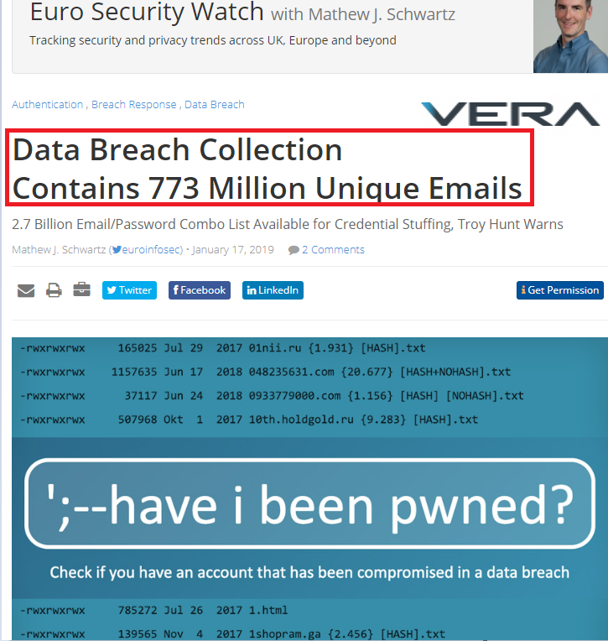
Hur hittar de mail adresserna?
- 773 million mailadresser, 22 miljoner med lösenord.
- 16,558,798 Svenska mailadresser https://www.bankinfosecurity.com/blogs/data-breach-collection-contains-773-million-unique-emails-p-2713 https://blog.defentry.com/blog/collection-1-defentry-has-the-file-and-here-is-what-we-found
Notes:
https://www.bankinfosecurity.com/blogs/data-breach-collection-contains-773-million-unique-emails-p-2713
https://blog.defentry.com/blog/collection-1-defentry-has-the-file-and-here-is-what-we-found

Slide 13
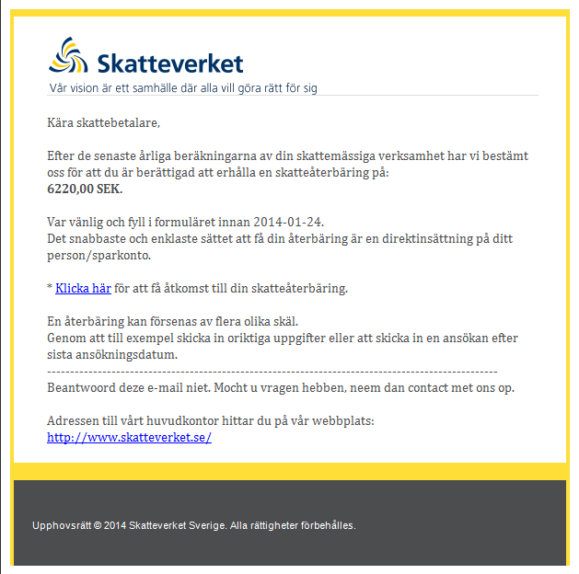
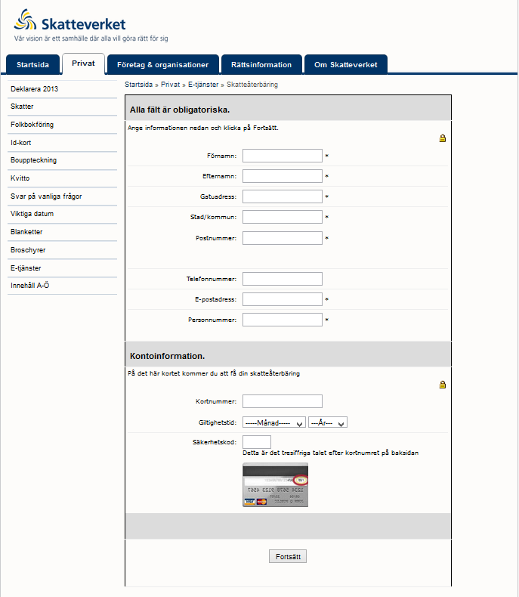
Traditionell Phishing

Slide 14
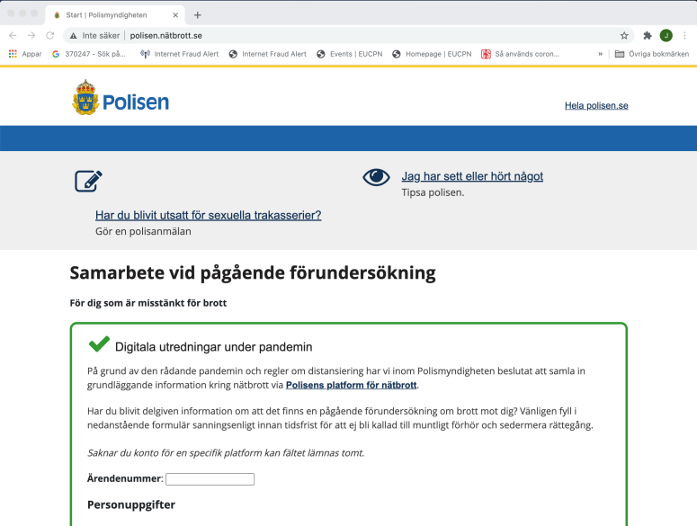
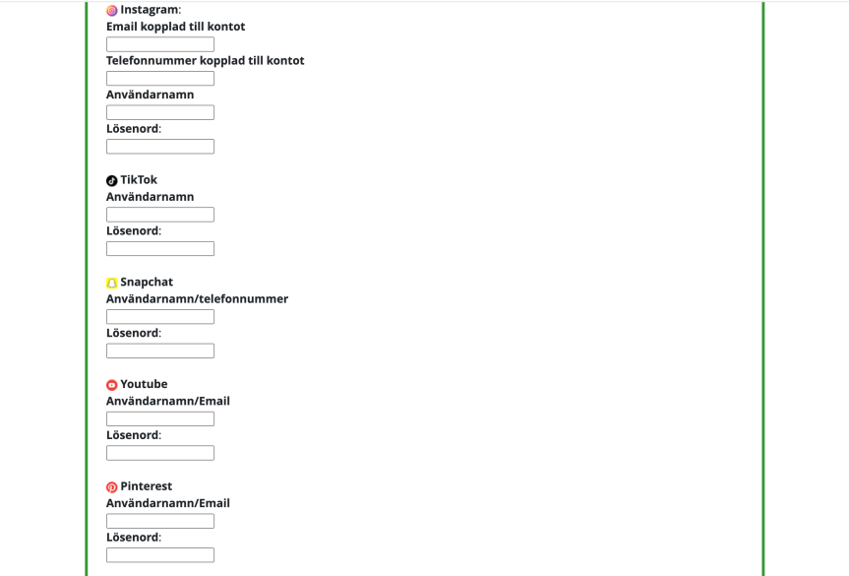
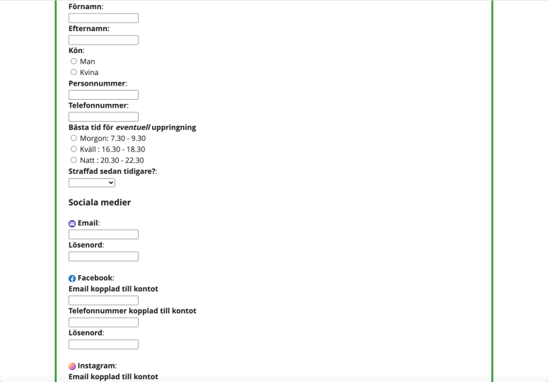
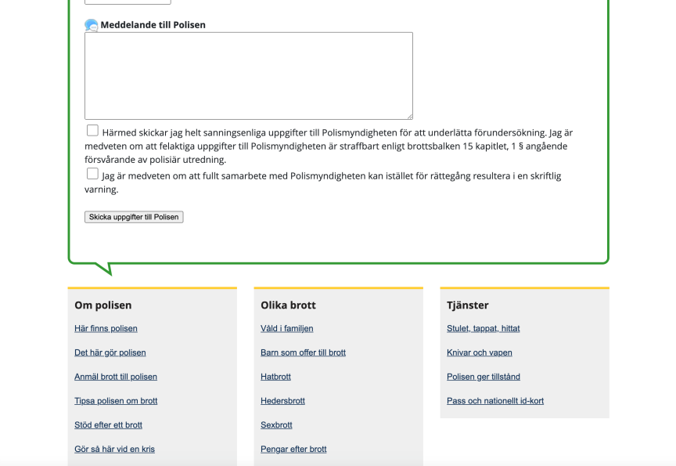

Slide 15
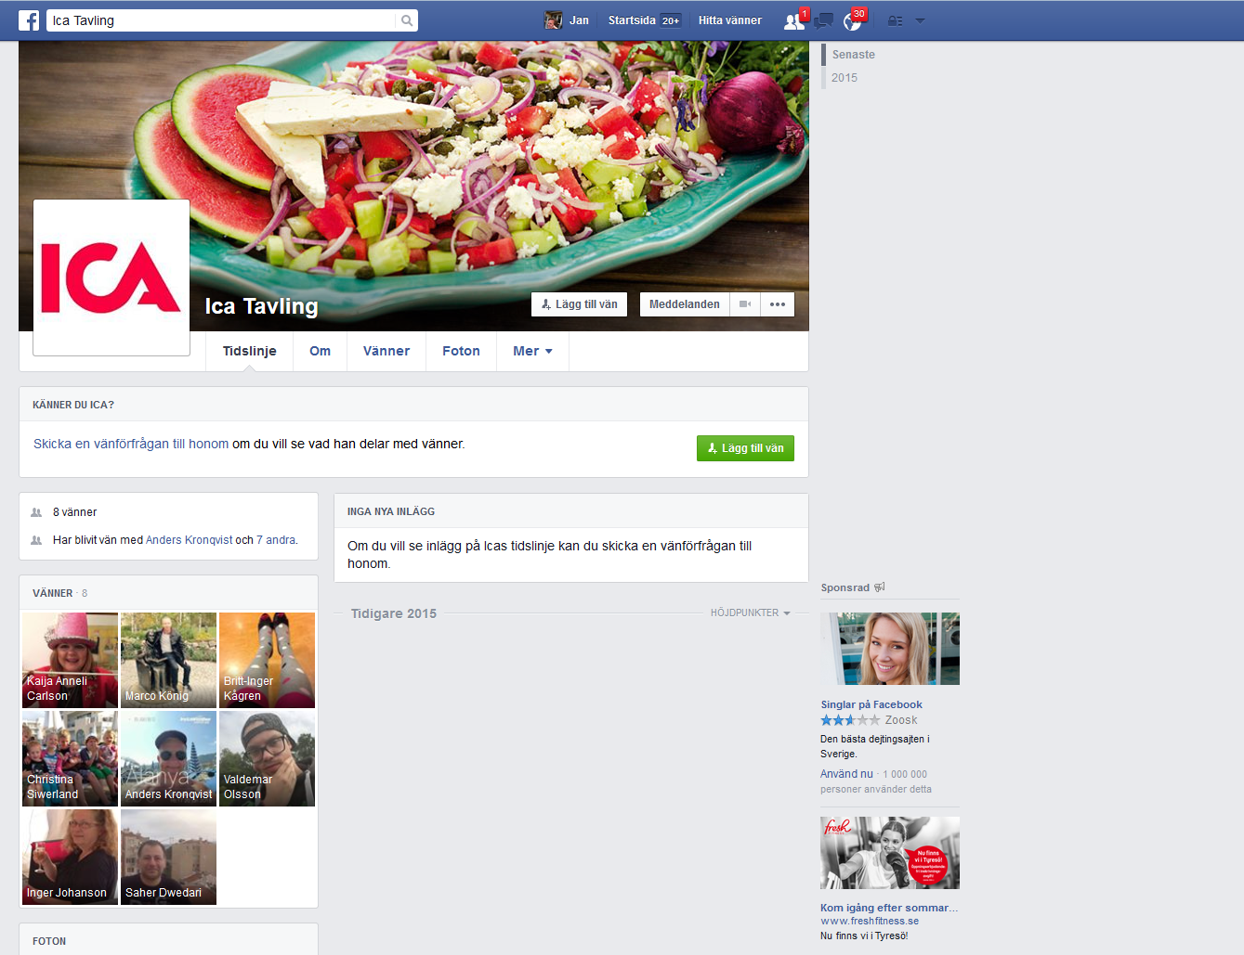
Spear Phishing – Riktad verksamhet

Slide 16
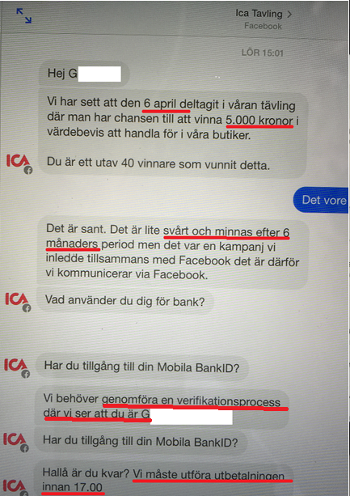
Konversation i messinger - Genomtänkt strategi !
Trygg igenkänd avsändare
Länge sedan – lätt att glömma
Inte iögonfallande hög summa
Avatar – rätt varumärke
Identifiera dig med BankID så du inte är en bedragare

Slide 17
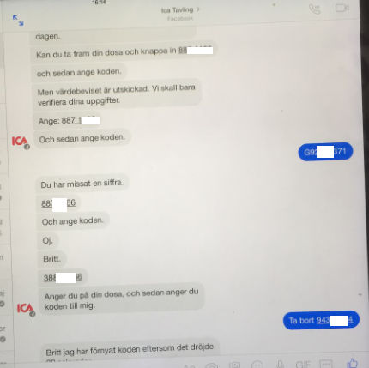

Slide 18
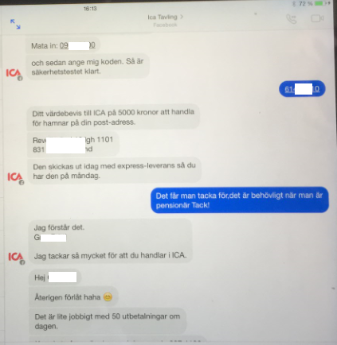

Slide 19
90.000 kr som denne säkert hade andra planer för försvann….
Efter detta har copycats fortsatt med ett flertal banker

Slide 20
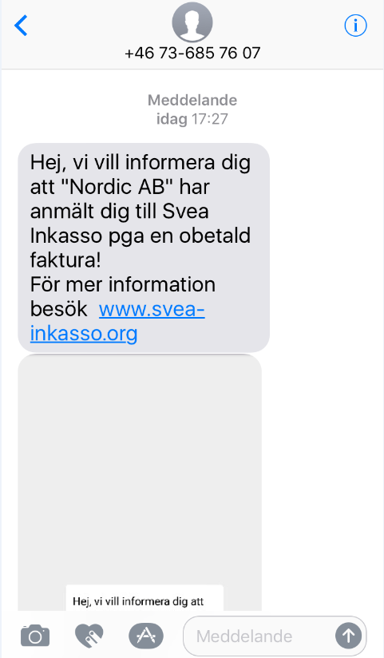
Smishing – Sms phishing

Slide 21
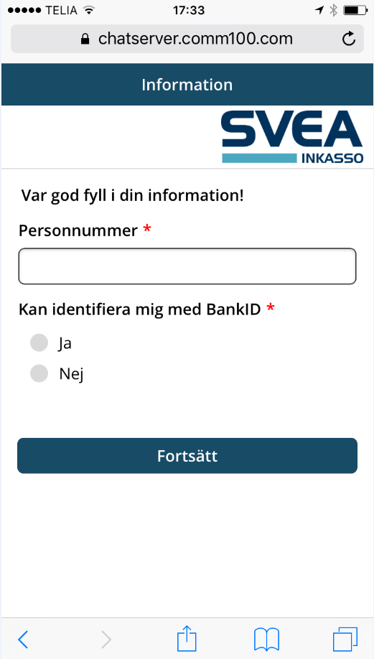
Sms påstår att du inte betalt en faktura. För att se den måste du naturligtvis identifiera dig med BankID förstås.
Först personnummer…

Slide 22
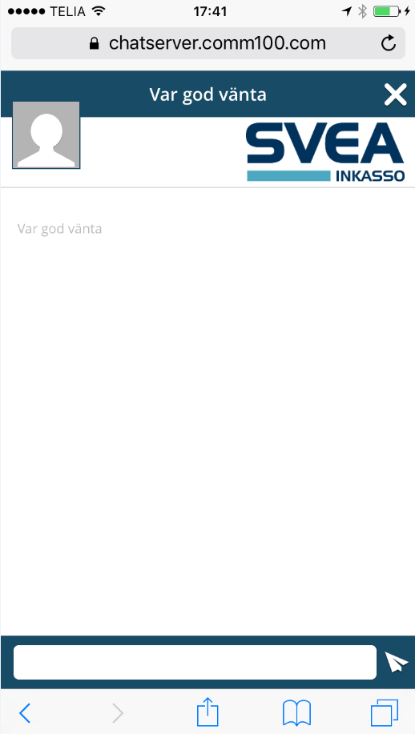
Därefter BankID koden

Slide 23
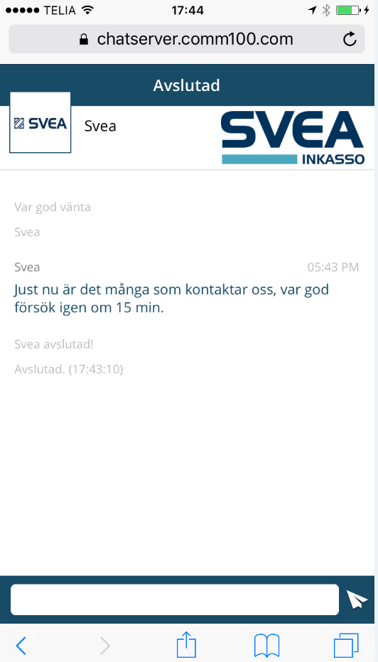
Tekniskt fel försök igen

Slide 24
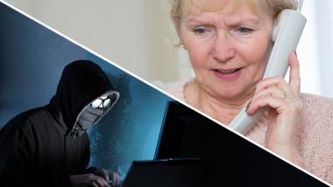
Vishing med Spoofing

Slide 25
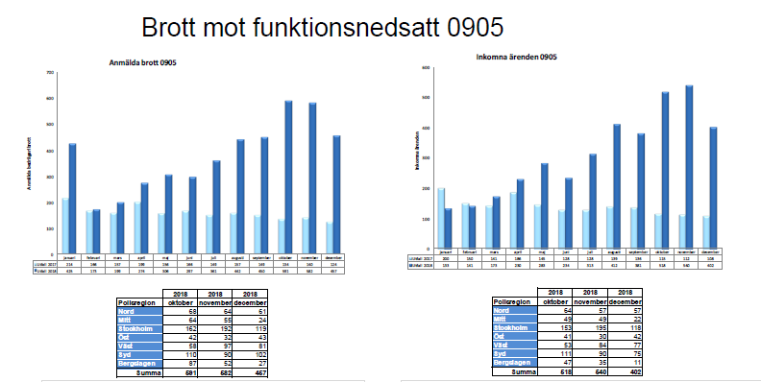
Åldringsbrott upp 138%

Slide 26
Brottsutveckling - telefonbedrägeri

Slide 27
Ransomware (Cryptolocker)
Nutid och framtid

Slide 28
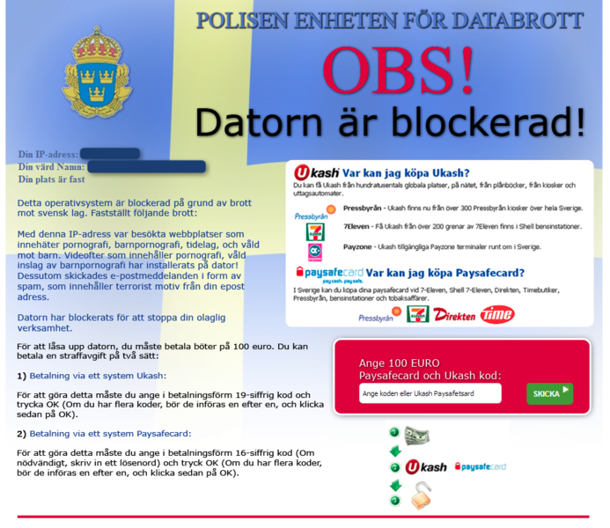
Ransomware traditionellt

Slide 29
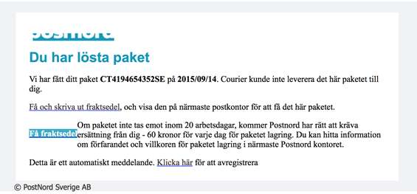
Mailutskick från Postnord, Nästa steg

Slide 30
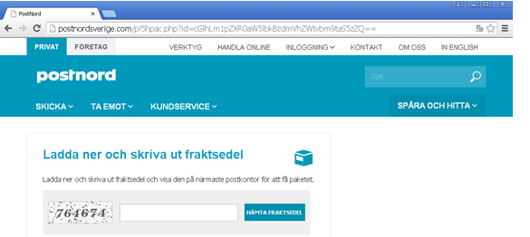
Klickar du vidare så kommer du hit

Slide 31
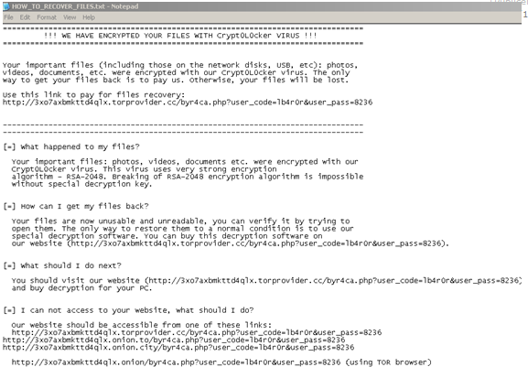
Skärmen låser sig en stund och sedan kommer instruktionerna

Slide 32
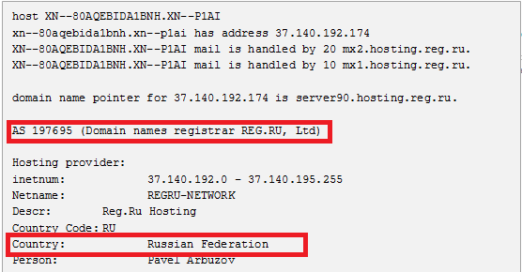
Och utskicket kommer ifrån…

Slide 33
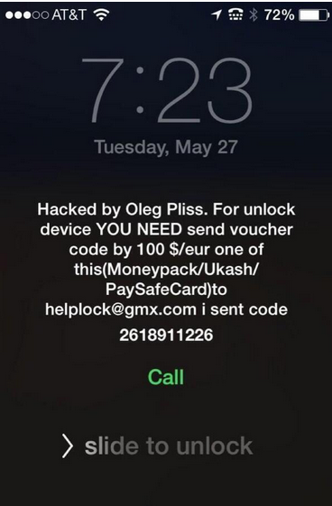
Eller i mobilen,paddan …

Slide 34

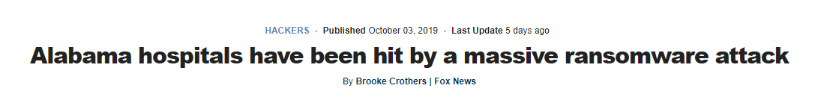

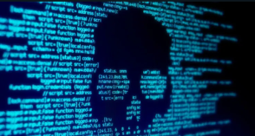
Ransomware hits Louisiana schools; state of emergency declared
Attackerna förändras mot att beröra speciella företag..
Georgia county pays a whopping $400,000 to get rid of a ransomware infection
Louisiana Governor John Bel Edwards
Naked Security
Notes:
https://www.zdnet.com/article/georgia-county-pays-a-whopping-400000-to-get-rid-of-a-ransomware-infection/
Officials in Jackson County, Georgia, paid $400,000 to cyber-criminals this week to get rid of a ransomware infection and regain access to their IT systems.
MORE SECURITY NEWS
WordPress shopping sites under attack
Google Chrome to block automatic downloads initiated from ad slot iframes
RSA Conference and the dismal nature of cybersecurity (Reporter's Notebook)
Samsung Galaxy S10 facial recognition fooled by a video of the phone owner
The ransomware hit the county's internal network last week, on Friday, March 1, 11Alive reported on Wednesday.
The infection forced most of the local government's IT systems offline, with the exception of its website and 911 emergency system.
"Everything we have is down," Sheriff Janis Mangum told StateScoop in an interview. "We are doing our bookings the way we used to do it before computers. We're operating by paper in terms of reports and arrest bookings. We've continued to function. It's just more difficult."
Jackson County officials notified the FBI and hired a cyber-security consultant. The consultant negotiated with the ransomware operators, and earlier this week the Georgia county paid $400,000 to hackers to get a decryption key and re-gain access to their ransomed files.
County officials are in the process of decrypting affected computers and servers, Jackson County Manager Kevin Poe told Online Athens in an interview yesterday.
"We had to make a determination on whether to pay," Poe said. "We could have literally been down months and months and spent as much or more money trying to get our system rebuilt."
Poe identified the ransomware that infected the county's network as "Ryunk" --which is most likely Ryuk, a well-known ransomware strain that is currently undecryptable.
The Ryuk gang is believed to be operating out of Eastern Europe and for the past year has focused on targeting local government, healthcare, and large enterprise networks. They intentionally go after big targets as part of a tactic known as "big game hunting."
Ryuk ransomware is usually deployed on networks following infections with Emotet or Trickbot malware. However, Jackson County officials have not yet confirmed how hackers breached their network.
Jackson County won't be the victim who paid the largest ever ransom demand, though. This "honor" goes to South Korean web hosting firm Internet Nayana, which paid 1.3 billion won ($1.14 million) worth of bitcoins to a hacker following a ransomware attack in June 2017.
Jackson County Manager Kevin Poe also has a case when saying that the county would have spent more rebuilding its network than paying the hackers. Government officials in Atlanta, Georgia have ended up paying millions to rebuild their IT network following a similar ransomware attack in March 2018, a cost which ballooned from the initially estimated $2.6 million to around $17 million.
----------------
A hospital network in Alabama is the latest victim in a rash of ransomware attacks in the U.S.
The attack encrypted files and restricted access to computer systems at DCH Health Systems Regional Medical Center, Northport Medical Center and Fayette Medical Center, DCH said in a statement on Wednesday.
Tuscaloosa, Ala.-based DCH said it is still able to provide critical medical services, but non-emergency patients are being told to seek assistance from other providers while it works to restore its systems.
HOW TO PROTECT YOURSELF FROM RANSOMWARE USING WINDOWS 10
The medical staff have shifted to manual mode and are using paper copies instead of digital records, while the IT systems are down, DCH added.
Investigators cited the ransomware variant Ryuk as the culprit. Ryuk is used for tailored attacks, according to a description of the ransomware by Check Point Software, a cybersecurity firm.
“Its encryption scheme is…such that only crucial assets and resources are infected in each targeted network with its infection and distribution carried out manually by the attackers,” Check Point said.
Ransomware attacks on hospitals are particularly odious, say experts. “The fact that hackers target hospitals shows they have no remorse for the desperate patients who seek aid,” Felix Rosbach, a product manager at Comforte AG, told Fox News in a statement.
“Hospitals contain some of the most sensitive information we have, such as medical records, payment information and other personally identifiable information,” Rosbach added.
DCH said it is coordinating with law enforcement and will not, at this time, share specifics about the investigations underway or the perpetrator’s demands.
Ransomware runs rampant
In the first nine months of 2019, at least 621 government entities, health care service providers and school districts, colleges and universities were affected by ransomware, Emsisoft, an anti-malware firm, said in a report earlier this week.
“Municipal and emergency services have been interrupted, medical practices have permanently closed, ER patients have been diverted, property transactions halted, the collection of property taxes and water bills delayed, medical procedures canceled, schools closed and data lost,” Emsisoft said, citing high-profile incidents in its report.
A separate report from cybersecurity firm Armor said that in the first nine months of the year, ransomware infections have hit more than 500 U.S. schools.
In June, Lake City, Fla., fell victim to a Ryuk attack. The $460,000 ransom demand was covered by an insurance policy. However, the IT director was fired and not all of the data was recovered.
SEXTORTION SCAMS ARE BACK, SECURITY EXPERT WARNS
One month prior, Baltimore was hit by a strain of ransomware called RobinHood. The city refused to pay the $76,000 demanded, but the attack caused widespread disruption in city services and property transactions. The recovery costs have been estimated at $18.2 million.
New Bedford, Mass., was slammed with the largest publicly disclosed ransom demand – $5.3 million – during an attack in July. The city countered at $400,000 and was subsequently rejected. Recovery costs are estimated at less than $1 million and will be covered by insurance.
Sextortion is seeing an uptick after a lull at the beginning of the year.
After relative inactivity during the past several months, sextortion scams are back on the radar, according to Internet security firm Malwarebytes.
The basic template of the blackmail scheme hasn’t changed. It goes something like this: Your account has been hacked and we have video proof of you watching sexual content on porn sites. Now we demand immediate payment in Bitcoin or we will release the video to the public.
TURN OFF YOUR BLUETOOTH, WARN SECURITY EXPERTS
The extortionists often claim that they’ve installed a “special program” on a porn site and tracked the victim accessing sexual content. They might also claim that they have gotten access to the victim’s desktop and web camera.
They also have various ways to keep the pressure on unwitting victims. In one scheme highlighted by Malwarebytes, the extortionist gives the victim two days to make a payment in the Bitcoin equivalent of $1,000. The bad guy claims to be monitoring the victim, resorting to ruses such as saying they are using Facebook Pixel – code that collects user interactions from websites for advertising purposes – to monitor the victim.
Extortionists are able to convince victims that they have the goods on them by flaunting a victim’s breached credentials – such as usernames, passwords, and addresses – that have been gleaned from the Dark Web then bolstering this with training in the dark art of extortion via DIY extortion guides, according to a report from Digital Shadows, a U.K.-based cybersecurity company.
It’s all about the money
There was a surge in Internet extortion in 2018. The FBI’s Internet Crime Complaint Center (IC3) received 51,146 extortion-related complaints with adjusted losses of over $83 million, representing a 242 percent increase in extortion-related complaints over 2017, according to the FBI’s 2018 Internet Crime Report.
ELECTION MACHINE KEYS ARE ON THE INTERNET, HACKERS SAY
Between July 2018 and February 2019, Digital Shadows had analyzed a sample of sextortion emails in which 89,000 addresses received over 790,000 sextortion attempts.
The Digital Shadows report also finds that fledgling extortionists are enticed by the promise of high salaries, especially if they are able to land high-income targets, such as doctors, lawyers, or company executives. That kind of personal financial information can be found, for example, by searching LinkedIn profiles.
Some criminal groups are promising salaries averaging the equivalent of $360,000 per year "to accomplices who can help them target high-worth individuals," Digital Shadows said.
One campaign highlighted by Malwarebytes (involving criminals using sextortion among other activities) collected approximately US$16,100. A broader campaign -- which covers various kinds of criminal activity including extortion -- brought in 21.6847451 in Bitcoin or a little over $220,000 at current exchange rates.
CLICK HERE TO GET THE FOX NEWS APP
“Sextortion scams are rooted in social engineering ploys that con artists and criminals of all kinds have devised over time. From the messaging to handling payments, this is a well-articulated business that will most likely keep gaining traction as it has shown to be highly profitable,” William Tsing of Malwarebytes, told Fox News.
-------------------------------------------
Louisiana Governor John Bel Edwards on Wednesday declared a state of emergency after three public school districts were seized by ransomware.
According to local news station KSLA, one of the affected school districts, Sabine Parish in northern Louisiana, released this statement on Wednesday night:
The Sabine Parish School System was hit with an electronic virus early Sunday morning. This virus has disabled some of our technology systems and our central office phone system. The district staff reported this electronic viral attack to local law enforcement, state officials and the FBI. All available resources are being utilized to get the district systems back online. An investigation involving local, state and federal law enforcement is ongoing at this time. The school phone systems were not affected by this attack. The central office phone system is being repaired and service will be restored as soon as possible. According to the Louisiana Department of Education, several other school districts were attacked by the same virus this week.
We haven’t seen details yet on what ransomware variant was inflicted in the attack; nor have state officials released a comprehensive list of the affected systems.
Eddie Jones, principal of Florien High School in Sabine Parish, told KSLA that his technology supervisor got an alert on his phone around 4am Sunday about a surge in bandwidth usage. It was particularly unusual given the time of day and the fact that the schools are all on summer break.
When technical staff investigated, Jones said, they found ransomware on the servers.
The principal said that he doesn’t believe that any sensitive information was lost. What was lost: “anything and everything” stored on the school district’s servers, including 17 years’ worth of Jones’ personal documents – his speeches, test schedules, master schedules and more.
The declaration of a state of emergency means that state resources will be made available and that assistance will be coming from cybersecurity experts from the Louisiana National Guard, Louisiana State Police, the Office of Technology Services and others to assist local governments in responding to the crisis and in preventing further data loss.
Solve your family’s frantic IT worries.
Play Video Try for Free
This is the first time that Louisiana has activated its emergency cybersecurity powers, which were created for just this type of cyberattack. The response is being handled by the state’s newly formed Cyber Security Commission, which was established in 2017. It brings together the state’s key stakeholders, subject matter experts, and cybersecurity professionals from Louisiana’s public sector, private industry, academia, and law enforcement.
The Governor’s Office of Homeland Security and Emergency Preparedness (GOHSEP) has also activated its Crisis Action Team and the Emergency Services Function-17 to coordinate a response.
Governor Edwards:
The state was made aware of a malware attack on a few north Louisiana school systems and we have been coordinating a response ever since. This is exactly why we established the Cyber Security Commission, focused on preparing for, responding to and preventing cybersecurity attacks, and we are well-positioned to assist local governments as they battle this current threat.
Ars Technica put some interesting context around Louisiana’s response: it’s modeled on Colorado’s response in the wake of two SamSam ransomware attacks. The first hit in February 2018, and the second came the following week. The attacks wound up costing the state $1.5 million to disinfect its systems after officials decided against paying nary one thin dime to the attackers.
Declaring an emergency empowered Colorado cybersecurity agencies to ask for help from the National Guard, on top of help from other security companies and the FBI.
The emergency declaration includes protection from being price-gouged for the extra help and resources. Here’s some language concerning that protection, from a Louisiana proclamation about states of emergency:
During a declared state of emergency, the prices charged or value received for goods and services sold within the designated emergency area may not exceed the prices ordinarily charged for comparable goods and services in the same market area at or immediately before the time of the state of emergency, unless the price by the seller is attributable to fluctuations in applicable commodity markets, fluctuations in applicable regional or national market trends, or to reasonable expenses and charges and attendant business risk incurred in procuring or selling the goods or services during the state of emergency.
How to protect yourself from ransomware
Pick strong passwords. And don’t re-use passwords, ever.
Make regular backups. They could be your last line of defence against a six-figure ransom demand. Be sure to keep them offsite where attackers can’t find them.
Patch early, patch often. Ransomware like WannaCry and NotPetya relied on unpatched vulnerabilities to spread around the globe.
Lock down RDP. Criminal gangs exploit weak RDP credentials to launch targeted ransomware attacks. Turn off RDP if you don’t need it, and use rate limiting, 2FA or a VPN if you do.
Use anti-ransomware protection. Sophos Intercept X and XG Firewall are designed to work hand in hand to combat ransomware and its effects. Individuals can protect themselves with Sophos Home”>XG Firewall are designed to work hand in hand to combat ransomware and its effects. Individuals can protect themselves with Sophos Home.
-----------------------------------------------------------------------------------------
https://nakedsecurity.sophos.com/2020/02/20/ransomware-attack-forces-2-day-shutdown-of-natural-gas-pipeline/
The US Department of Homeland Security (DHS) on Tuesday said that an infection by an unidentified ransomware strain forced the shutdown of a natural-gas pipeline for two days.
Fortunately, nothing blew up. The attacker never got control of the facility’s operations, the human-machine interfaces (HMIs) that read and control the facility’s operations were successfully yanked offline, and a geographically separate central control was able to keep an eye on operations, though it wasn’t instrumental in controlling them.
Where this all went down is a mystery.
The alert, issued by DHS’s Cybersecurity and Infrastructure Security Agency (CISA), didn’t say where the affected natural gas compression facility is located. It instead stuck to summarizing the attack and provided technical guidance for other critical infrastructure operators so they can gird themselves against similar attacks.
The alert did get fairly specific with the infection vector, though: whoever the attacker was, they launched a successful spearphishing attack, which enabled them to gain initial access to the facility’s IT network before pivoting to its operational technology (OT) network.
OT networks are where hardware and software for monitoring and/or controlling physical devices, processes and events reside. Some examples are SCADA industrial control systems, programmable logic controllers (PLCs), and HMIs.
After the attacker(s) got their hands on both the IT and OT networks, they deployed what CISA called “commodity” ransomware, encrypting data on both networks. Staff lost access to HMIs, data historians and polling servers. Data historians – sometimes referred to as process or operational historians – are used in several industries, and they do what you might expect: record and retrieve production and process data by time and store the information in a time series database.
Although humans partially lost their view of some low-level OT devices, the attack didn’t affect PLCs, and hence, the facility never lost control of operations. From the alert:
At no time did the threat actor obtain the ability to control or manipulate operations.
CISA’s alert also noted that, although the victimized facility’s emergency response plan didn’t specifically take cyberattacks into consideration, a decision was made to implement what DHS called a “deliberate and controlled shutdown” of operations. That shutdown lasted about two days. It also affected other compression facilities that were linked to the victimized site, the advisory said:
Geographically distinct compression facilities also had to halt operations because of pipeline transmission dependencies.
As a result, “the entire pipeline asset” had to be shut down for two days, not just the victimized compression facility.
Why, in this day and age, when ransomware and other malware attacks are running amok, would cyberattacks have been left out of a utility company’s emergency response plan? CISA said in its advisory that the victimized facility pointed to a gap in cybersecurity knowledge being a mitigating factor: it’s at the heart of the facility’s failure to “adequately incorporate cybersecurity into emergency response planning.”
For years, DHS has been warning that enemy nations have been ready to disrupt US energy utilities.
In 2018, DHS’s chief of industrial-control-system analysis, Jonathan Homer, got specific. He said that between 2016 and 2018, Russian hackers snared “hundreds of victims” in the utilities and equipment sectors, to the point where “they could have thrown switches” in a way that could have caused power blackouts. Similarly to the recently announced natural-gas compression facility attack, those compromises also started with phishing attacks, according to Homer. He added that the attackers had, at the time, been sophisticated enough to even jump air-gapped networks.
Although we don’t know which malware strain was involved in this week’s advisory, Ars Technica notes that it comes two weeks after researchers from industrial cybersecurity firm Dragos reported that a ransomware strain known as EKANS had tampered with industrial control systems used by gas facilities and other critical infrastructure.
The world's best visibility, protection, and response.
Start Online Demo
Dragos reported that EKANS, a ransomware that emerged in December 2019, is pretty straightforward, as ransomware goes: it encrypts, it displays a ransom note. But beyond that, it’s been tailored to cripple industrial control systems in particular. From Dragos’s writeup:
EKANS featured additional functionality to forcibly stop a number of processes, including multiple items related to ICS operations. While all indications at present show a relatively primitive attack mechanism on control system networks, the specificity of processes listed in a static “kill list” shows a level of intentionality previously absent from ransomware targeting the industrial space.
ICS asset owners and operators are therefore strongly encouraged to review their attack surface and determine mechanisms to deliver and distribute disruptive malware, such as ransomware, with ICS-specific characteristics.
Mind you, we don’t know if EKANS was used in this recent incident at the natural-gas pipeline. What we do know: ransomware exists to specifically target such crucial infrastructure facilities, and operators should be aware of the risks that entails.
Again, CISA’s advisory provides guidance for critical infrastructure operators. Here’s additional guidance for the rest of us:
How to protect yourself from ransomware
Pick strong passwords. And don’t re-use passwords, ever.
Make regular backups. They could be your last line of defense against a six-figure ransom demand. Be sure to keep them offsite where attackers can’t find them.
Patch early, patch often. Ransomware like WannaCry and NotPetya relied on unpatched vulnerabilities to spread around the globe.
Lock down RDP. Criminal gangs exploit weak RDP credentials to launch targeted ransomware attacks. Turn off Remote Desktop Protocol (RDP) if you don’t need it, and use rate limiting, two-factor authentication (2FA) or a virtual private network (VPN) if you do.
Use anti-ransomware protection. Sophos Intercept X and XG Firewall are designed to work hand in hand to combat ransomware and its effects. Individuals can protect themselves with Sophos Home.
For information about how targeted ransomware attacks work and how to defeat them, check out the SophosLabs 2019 Threat Report.

Slide 35
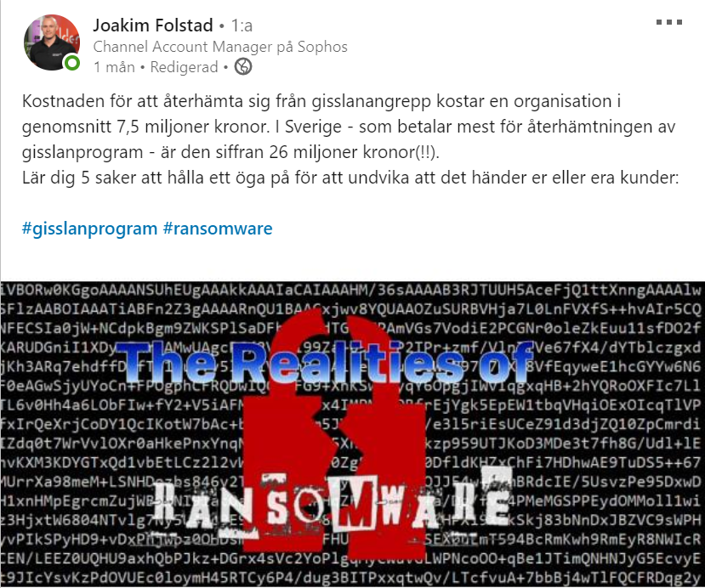
Ekonomiska konsekvenser..

Slide 36
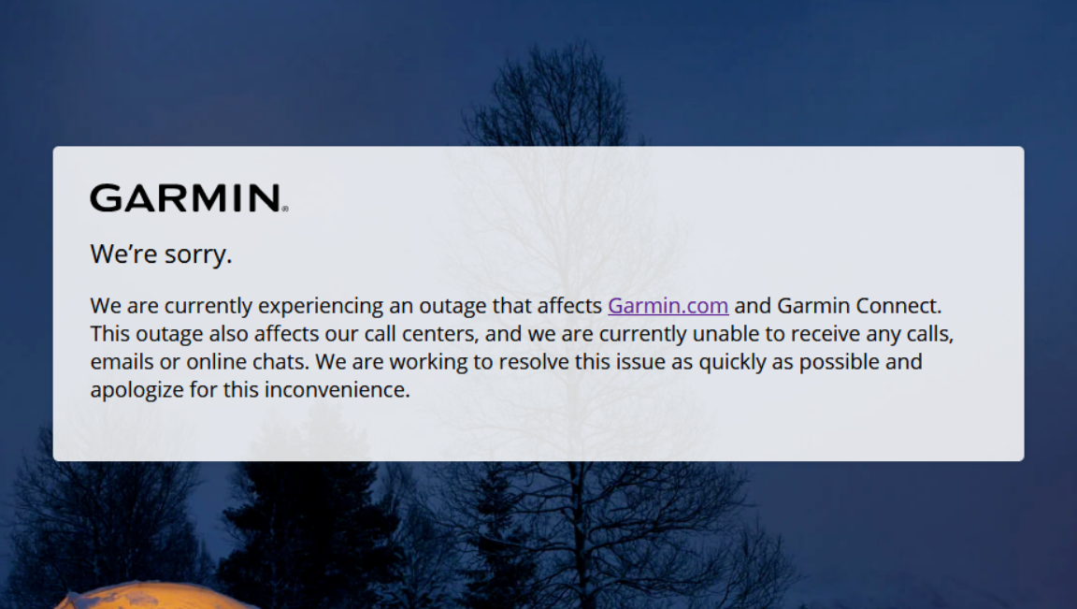

Ransom 100.000.000 kr

Slide 37
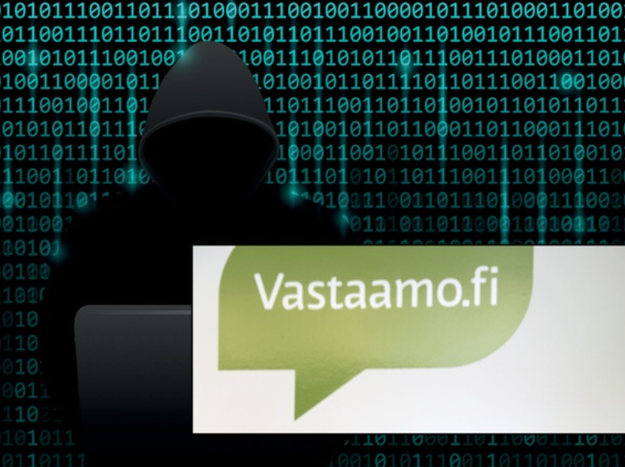
Double Trouble

Slide 38
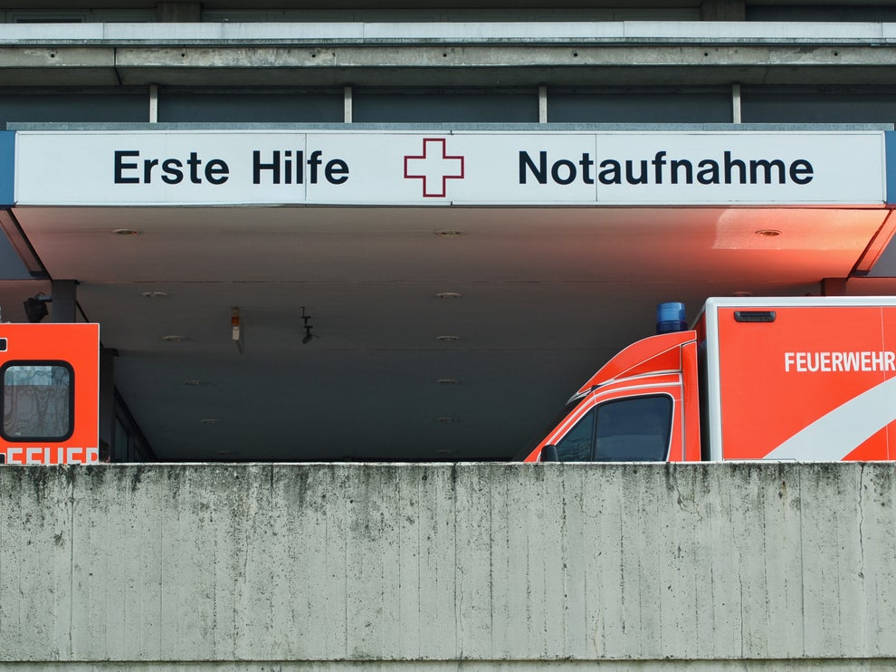
Ransomware tar liv
Notes:
A woman has died after hackers attacked a hospital in Germany, causing IT systems to crash and emergency patients to be rerouted to other hospitals.
The incident at Dusseldorf University Clinic prevented the hospital from accepting emergency patients last Friday, meaning ambulance drivers were forced to drive a woman in a critical condition to another facility 32km (20 miles) away.
The delay meant doctors were unable to treat the unnamed woman for an hour and she subsequently died.
Ransomware attacks on hospitals have become increasingly common in recent years, due to the tendency for many facilities to rely on old and out-dated IT infrastructure to store patient’s medical records and other vital information. This allows cyber attackers to gain access to computer systems relatively easily, before changing passwords and holding sensitive data for ransom.
Hackers typically demand a payment in bitcoin or another semi-anonymous cryptocurrency that is difficult for law enforcement to trace. One of the most notorious incidents saw the Hollywood Presbyterian Medical Center (HPMC) in Los Angeles knocked offline for several weeks in 2016, forcing staff to resort to handwritten notes and fax machines.
Administrators eventually decided to pay the $17,000 bitcoin in order to recover their systems, though cyber security experts warned that such action could encourage hackers and lead to a proliferation of ransomware attacks on hospitals and other critical infrastructure.
The latest extortion attempt against the Dusseldorf hospital was withdrawn after German police contacted the anonymous perpetrators. The incident may be the first time that a patient’s death has been directly attributed to a ransomware attack, with prosecutors currently investigating the hackers on suspicion of negligent manslaughter.

Slide 39

Darkside Ransomware is creating a secure data leak service in Iran!
R-a-a-S, so what´s the Fuzz..?
Notes:
The DarkSide Ransomware operation claims they are creating a distributed storage system in Iran to store and leak data stolen from victims. To show they mean business, the ransomware gang has deposited $320 thousand on a hacker forum.
DarkSide is run as a Ransomware-as-a-Service (RaaS) where developers are in charge of programming the ransomware software and payment site, and affiliates are recruited to hack businesses and encrypt their devices.
As part of this arrangement, the DarkSide ransomware developers receive a 10-25% cut, and an affiliate gets 75-90% of any ransom payments they generate.
Distributed storage system to leak data
Yesterday, cybersecurity intelligence firm Kela shared a new topic posted by the DarkSide Ransomware operators on a Russian-speaking hacker forum with BleepingComputer.
In this topic, DarkSide has stated that they are working on a distributed storage system to store and leak victims' stolen data.
Since late 2019, ransomware operations have been actively performing a double-extortion strategy of stealing unencrypted data and then encrypting the victim's computers. The encrypted files and the threat to publicly release data on ransomware data leak sites are used to extort victims into paying the ransom.
To disrupt these extortion demands, law enforcement and cybersecurity firms actively try to take down these data leak sites.
To prevent this, DarkSide states that they plan to create a distributed "sustainable storage system" in Iran to host the victim's stolen data for six months.
"Some targets think that if a lot of data has been downloaded from them, then after their publication, hackers and other people will download it for a long time through the TOR. We think so too, so we will change it."
DarkSide deposits $320 thousand on a hacker forum
As part of this same forum topic, the DarkSide operation announced that they were looking for new Russian affiliates to join their program, who they claim to earn an average of $400k per victim.
As part of this recruitment drive, affiliates must pass an interview and answer any questions the developers have about their level of experience.
"Pass an interview, show your work and payments, answer the necessary questions." - DarkSide developers.
Unlike other ransomware operations, such as Ryuk, Egregor, and others, DarkSide states that do not allow attacks on:
Medicine (hospitals, hospices).
Education (schools, universities).
Non-profit organizations.
Government sector.
It is too soon to tell if DarkSide will keep its promises about not targeting these organizations.
In addition to recruiting affiliates, DarkSide states that they are willing to spend 400K to hackers with access to large companies in the USA that can be encrypted.
To back up their claims, the DarkSide gang deposited 20 bitcoins on the forum, which is worth approximately $320 thousand at today's values.

Slide 40
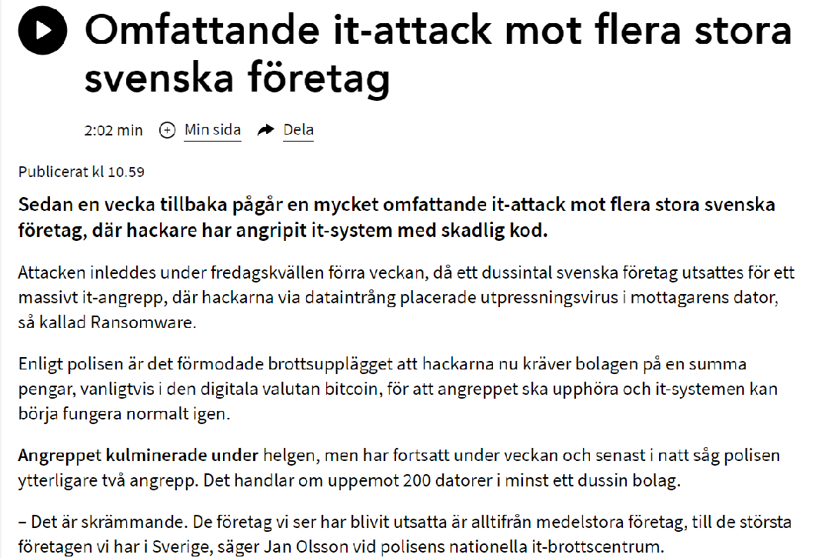
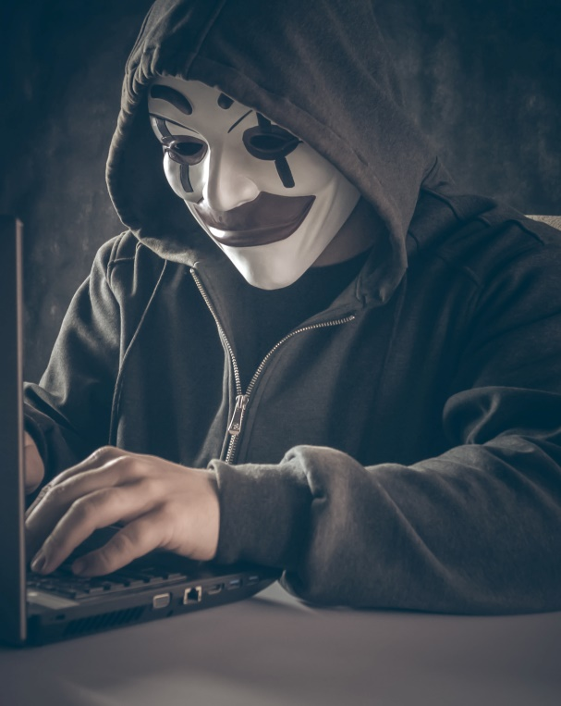
Black Friday - endast toppen av ett isberg

Slide 41
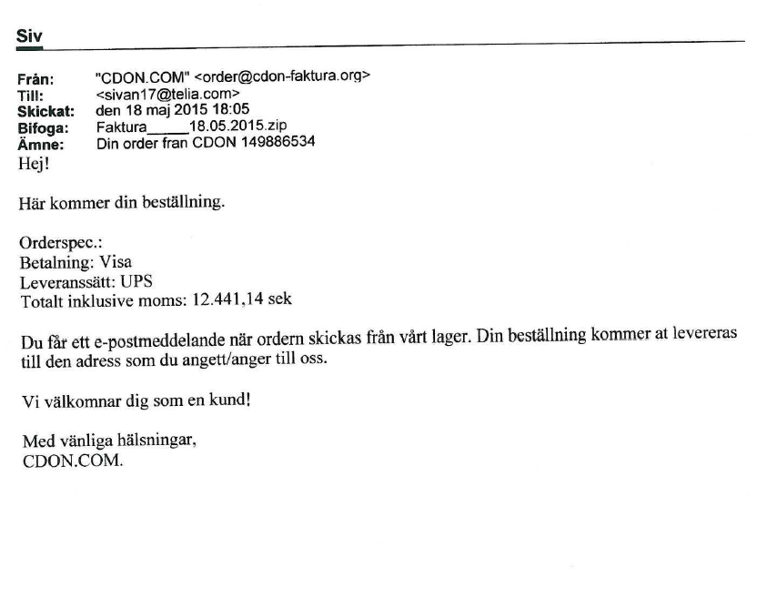
Banktrojan Retefe (Rovnix)
Phishingmailet

Slide 42
Flödesschema
Rysk Kärlek
Eller kriminell?
Bank 1
Offer
Penning-tvättare
WU
Penning- tvättare
200/timme
Mastermind
Penning- tvättare
WU
Penning- tvättare
Bank 2
Offer
Rysk kärlek
Eller kriminell?
Servrar i Tyskland och Holland
IT brottsling
Notes:
Crime-as-a-service ”Blackhole Exploit Kit”-Dmitry ”Paunch” Fedotov 7 år 12 april 2016, 1000 kunder X 400.000 kr/månad. Föddes 2010.

Slide 43
Phishing, vem är dum nog att gå på det…..

Slide 44
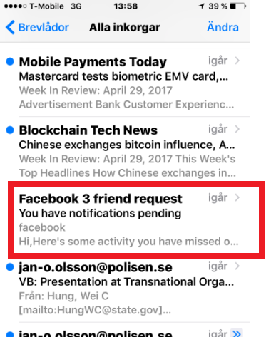
Kul i telefonen

Slide 45
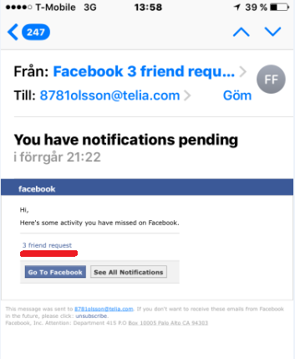
Äntligen är man populär!

Slide 46

Men vad i he…..

Slide 47

Lösenord, det sista skyddet..

Slide 48
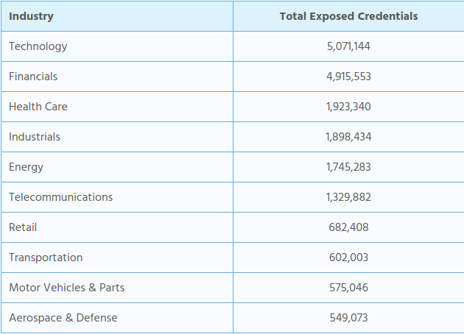
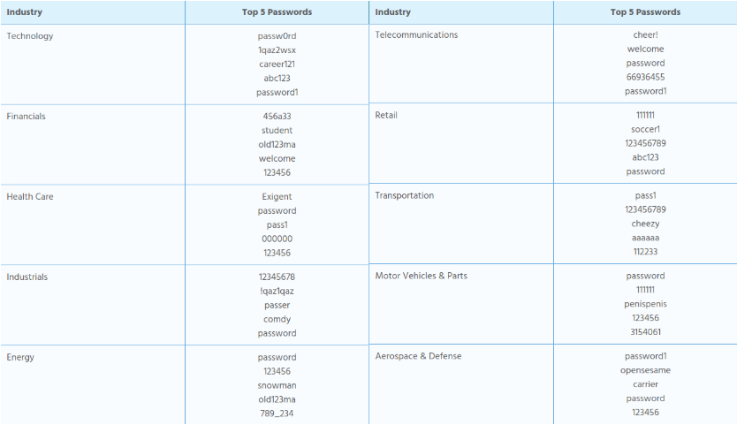
Starka lösenord ?
(Gunnebo !!)
2(2)

Slide 49
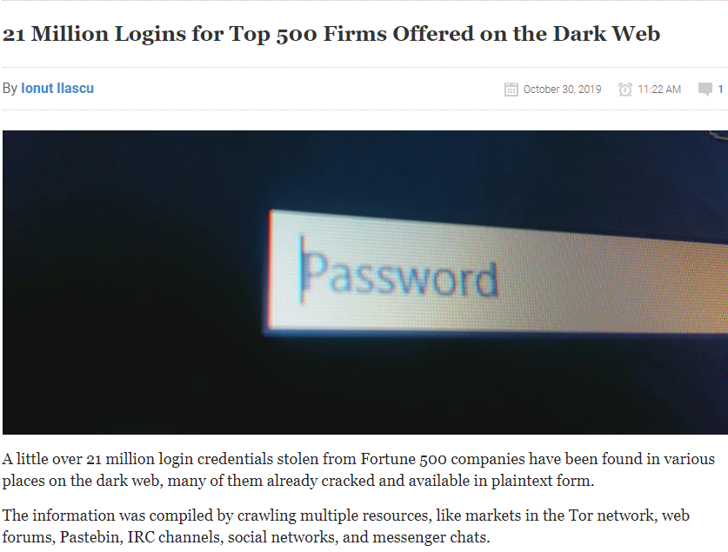
Are we secured ?
1(2)
Notes:
21,040,296 is the exact number of credentials belonging to companies ranking in the first 500 that security researchers found on the web.
Most of them were from tech companies, closely followed by organizations in the financial industry. Entities in the healthcare, energy, telecommunications, retail, industrial, transport, aerospace and defense sectors are also on the list.
However, the researchers reveal a worrying statistic: "95% of the credentials contained unencrypted, or brute-forced and cracked by the attackers, plaintext passwords.“

Slide 50
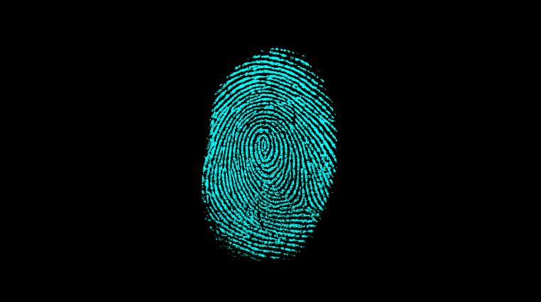
Säker identifiering?

Slide 51
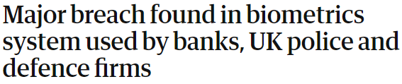
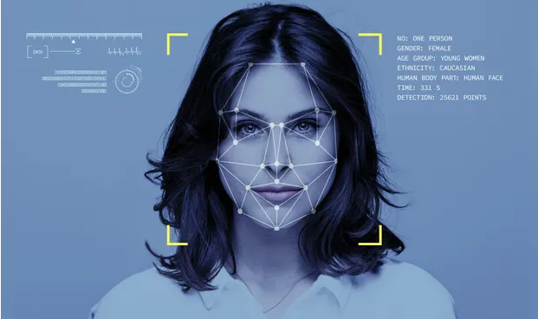
(28 million records)
Notes:
The fingerprints of over 1 million people, as well as facial recognition information, unencrypted usernames and passwords, and personal information of employees, was discovered on a publicly accessible database for a company used by the likes of the UK Metropolitan police, defence contractors and banks.
Suprema is the security company responsible for the web-based Biostar 2 biometrics lock system that allows centralised control for access to secure facilities like warehouses or office buildings. Biostar 2 uses fingerprints and facial recognition as part of its means of identifying people attempting to gain access to buildings.
Last month, Suprema announced its Biostar 2 platform was integrated into another access control system – AEOS. AEOS is used by 5,700 organisations in 83 countries, including governments, banks and the UK Metropolitan police.
The Great Hack: the film that goes behind the scenes of the Facebook data scandal
Read more
The Israeli security researchers Noam Rotem and Ran Locar working with vpnmentor, a service that reviews virtual private network services, have been running a side project to scans ports looking for familiar IP blocks, and then use these blocks to find holes in companies’ systems that could potentially lead to data breaches.
In a search last week, the researchers found Biostar 2’s database was unprotected and mostly unencrypted. They were able to search the database by manipulating the URL search criteria in Elasticsearch to gain access to data.
The researchers had access to over 27.8m records, and 23 gigabytes-worth of data including admin panels, dashboards, fingerprint data, facial recognition data, face photos of users, unencrypted usernames and passwords, logs of facility access, security levels and clearance, and personal details of staff.
Much of the usernames and passwords were not encrypted, Rotem told the Guardian.
“We were able to find plain-text passwords of administrator accounts,” he said.
“The access allows first of all seeing millions of users are using this system to access different locations and see in real time which user enters which facility or which room in each facility, even.”
“We [were] able to change data and add new users,” he said.
This would mean that he could edit an existing user’s account and add his own fingerprint and then be able to access whatever building that user is authorised to access, or he could just add himself as a user with his photo and fingerprints.
In the paper about the discovery provided to the Guardian before being published by vpnmentor on Wednesday, the researchers said they were able to access data from co-working organisations in the US and Indonesia, a gym chain in India and Sri Lanka, a medicine supplier in the United Kingdom, and a car parking space developer in Finland, among others.
The researchers said the sheer scale of the breach was alarming because the service is in 1.5m locations across the world and because, unlike passwords being leaked, when fingerprints are leaked, you can’t change your fingerprint.
“Instead of saving a hash of the fingerprint (that can’t be reverse-engineered) they are saving people’s actual fingerprints that can be copied for malicious purposes,” the researchers said in the paper.
The researchers made multiple attempts to contact Suprema before taking the paper to the Guardian late last week. Early Wednesday morning (Australian time) the vulnerability was closed, but they still have not heard back from the security firm.
Chinese cyberhackers 'blurring line between state power and crime'
Read more
Suprema’s head of marketing, Andy Ahn, told the Guardian the company had taken an “in-depth evaluation” of the information provided by vpnmentor and would inform customers if there was a threat.
“If there has been any definite threat on our products and/or services, we will take immediate actions and make appropriate announcements to protect our customers’ valuable businesses and assets,” Ahn said.
Advertisement
Rotem said the problem wasn’t unique to Suprema.
“It’s very common. There’s literally millions of open systems, and going through them is a very tedious process,” he said. “And some of the systems are quite sensitive.”
He said supply chain vulnerabilities – where a company uses a third-party company for a service that doesn’t have appropriate security – was common but often some of the vulnerabilities discovered were with Fortune 500 companies.
Rotem said he contacts around three or four companies per week with similar issues. Earlier this year, Rotem pointed out a substantial flaw in Amadeus’s flight booking system.
“Mistakes happen, and the real test is how you handle them,” Rotem said. “If you have a security team that can respond quickly and efficiently it’s good enough. If you have a security team that will send a legal team to threaten you, well, it’s less efficient.
“And this happens quite a lot. It’s unpleasant for someone to point out you have a vulnerability or weakness. Some people take it as an opportunity to fix it and some people are offended by it for some reason.”

Slide 52

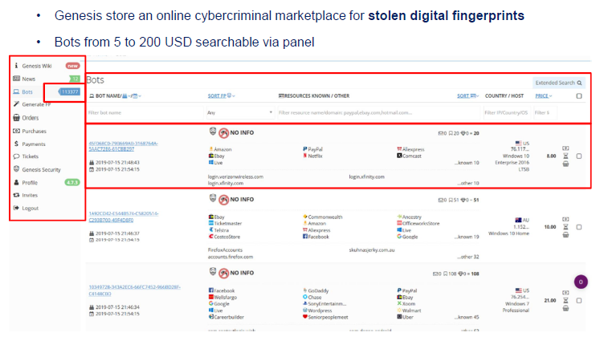
Notes:
För att motverka att obehöriga personer hackar sig in på kunders konton och gör beställning av varor/tjänster vid onlinehindel har företag utvecklat sofistikerade motmedel i form av fraud prevention software. Försöker man använda ett konto, trots rätt användarnamn och lösenord men använder en ny enhet, kopplar upp sig från en annan del av världen eller har ett avvikande tidsmönster, görs extra kontroller för att verifiera kundens identitet. Programvaran som används utnyttjar 100-tals parametrar för att profilera användaren, användarens vanor och användarens it-system och skapar med hjälp av dessa ett digitalt fingeravtryck som används för denna extra monitorering.
Sedan en tid finns nu en tjänst på öppna nätet som heter Genesis Marketplace. Här säljs tillgång till användares faktiska it-system som sedan kan kan användas av en förövare för att komma åt olika konton. Uppkopplingarna mot onlinehandel görs då från den riktiga innehavarens maskin med den riktiga innehavarens uppgifter, vilket gör att man kommer förbi de extra lagren av skydd som digitala fingeravtryck medför.
Bland de konton/användare som finns ute till försäljning finns brottsoffer från alla Europols medlemsländer samt de flesta tredje parter. Samtliga av dessa användare är alltså utsatta för dataintrång och direkt sårbara för bedrägerier mm genom den tillgång man får till deras system.

Slide 53
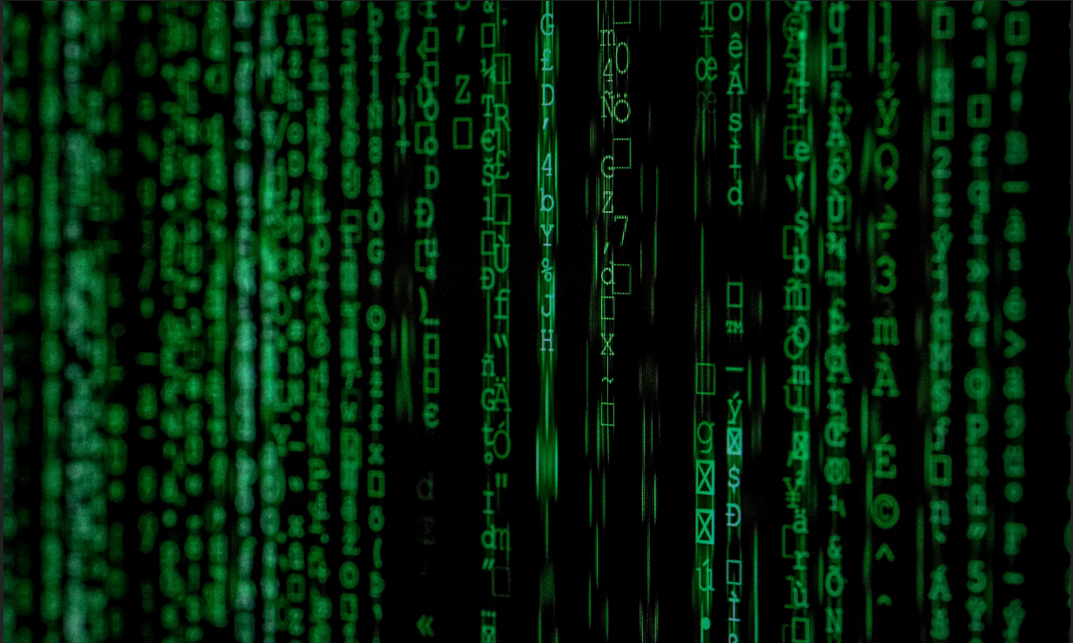
Mer ?
Jan Olsson
070-736 49 32
Jan-o.olsson@polisen.se

